Slide 1

Sitecore MAUI SDK

Slide 2
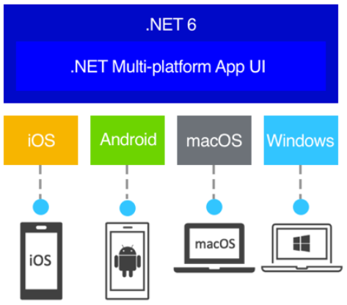
? What is .Net MAUI
.NET Multi-platform App UI (.NET MAUI) is a cross-platform framework for creating native mobile and desktop apps with C# and XAML.

Slide 3
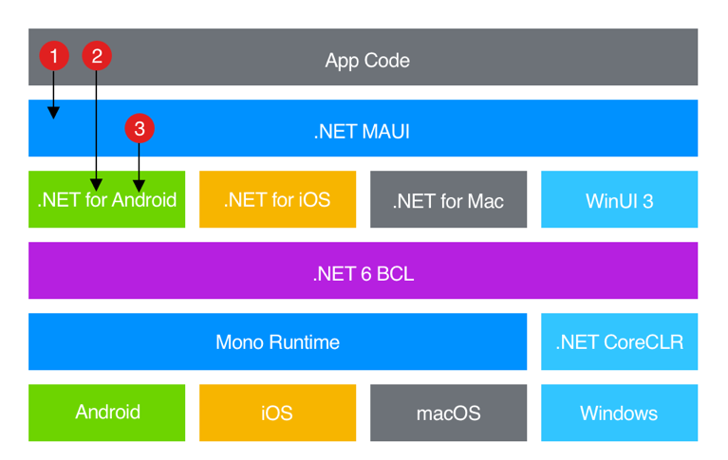
? Who .NET MAUI is for
.NET MAUI is for developers who want to:
Write cross-platform apps in XAML and C#, from a single shared code-base in Visual Studio.
Share UI layout and design across platforms.
Share code, tests, and business logic across platforms.

Slide 4


? What is Sitecore MAUI SDK
Build your .Net MAUI app with Sitecore MAUI SDK
+
Sitecore MAUI SDK

Slide 5
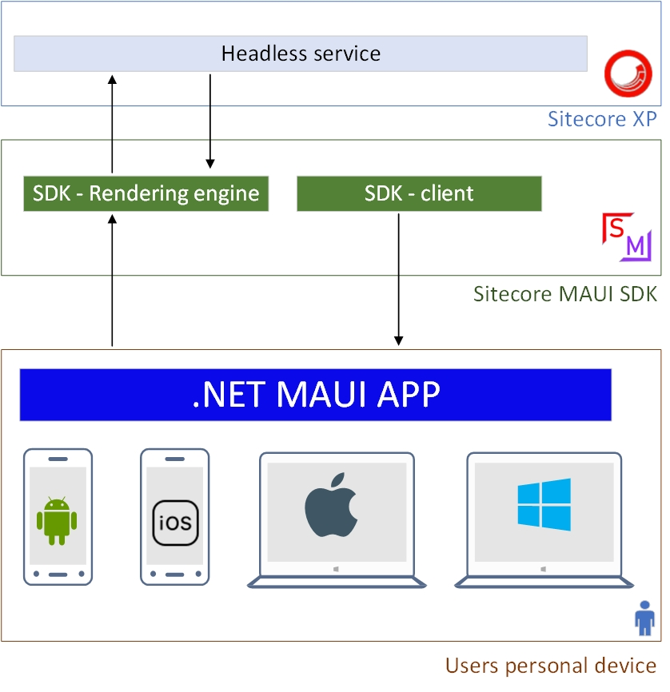
? How Sitecore MAUI SDK is working

Slide 6
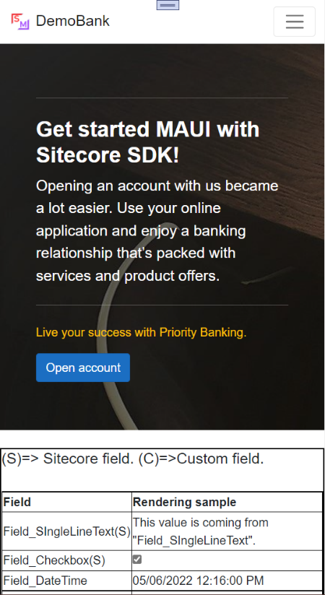
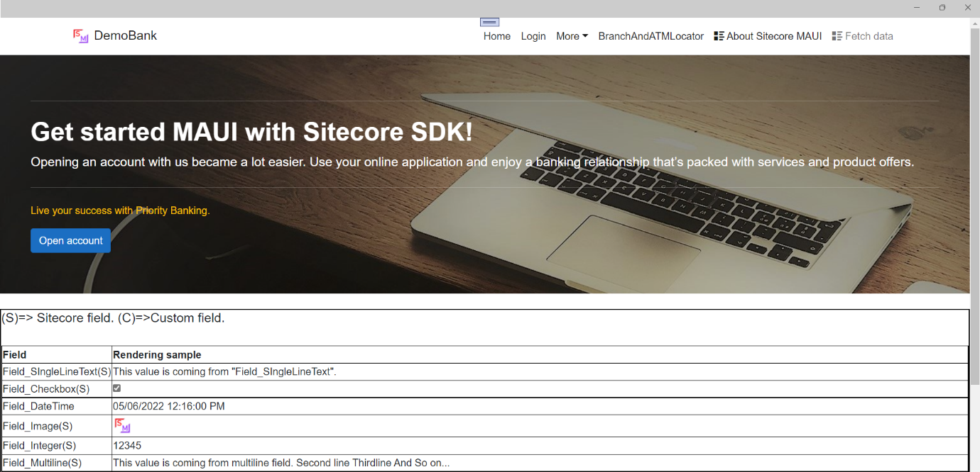
Sample APP
Desktop APP
Android App

Slide 7
Reference
Website : https://sitecoremaui.wordpress.com
GITHUB : https://github.com/andiappan-ar/Sitecore.DemoBank/tree/master/Src/MAUI
Nugget : https://www.nuget.org/packages?q=sitecore+maui+sdk

